Slide 1

WIPRO NGA Program – DWS
Capstone Project Presentation – 4rd September 2025
Title : - Add a Launch Condition Restrict installation to certain OS versions or hardware
Presented by :
34753-Sooraj B
34869-Musaif Attar
www.rpsconsulting.in

Slide 2


Application
Repackaging
2025 - RPS Consulting all rights reserved

Slide 3
INTRODUCTION :-
This project demonstrates creating a restricted software installer that uses a launch condition to ensure an application is only installed on a specific OS. The two-step process, using an application re-packager and an installer tool, prevents compatibility issues and reduces support overhead. The final product is a reliable package that validates the system before installation.
2025 - RPS Consulting all rights reserved

Slide 4
What is application
Repackaging:-
Application repackaging converts an original software installer into a new, standardized package like an MSI.
It works by capturing all system changes made during a clean installation. This new package is highly customizable, enabling silent installations and simplifying large-scale software deployment for administrators.
2025 - RPS Consulting all rights reserved

Slide 5
Benefits :-
Standardization: Repackaging converts various installation formats into a single, uniform standard like MSI. This simplifies software management and large-scale deployment by providing a consistent installation experience across all applications.
Customization: It allows for extensive modifications to the original installation, such as adding or removing components and pre-configuring settings. This enables administrators to tailor applications to meet specific organizational requirements without needing the source code.
Troubleshooting & Compatibility: By creating a detailed record of an application's system changes, repackaging makes it easier to troubleshoot issues. It also allows for the implementation of launch conditions to prevent installation on unsupported systems, proactively ensuring compatibility.
2025 - RPS Consulting all rights reserved

Slide 6
Objective: To implement a launch condition in a repackaged software installer to ensure it can only be installed on specific operating system (OS) versions or hardware, thereby preventing compatibility issues.
Prerequisites:
1.Clean Virtual Machine to perform the Activity.
2.Advanced Installer & Re-installer Package.
3.The Application which is to be repackaged- Cloudflare WARP
2025 - RPS Consulting all rights reserved

Slide 7
Minimum System Requirements
CPU: A Core 2 class processor or equivalent is the baseline.
RAM: You need at least 1 GB of RAM to run the application.
Storage: A minimum of 2 GB of free hard drive space is required for installation and operation.
Display: The minimum supported screen resolution is 1366x768.
Operating System: Advanced Installer requires Windows 10 or newer to run.
2025 - RPS Consulting all rights reserved

Slide 8
Workflow Diagram
Verify all the prerequisites and Start with a clean Virtual Machine
Open the application in Advanced Repackage and take the initial snapshot
Perform the Installation steps, finish it and take the final snapshot
Review the changes it made and proceed to edit in Advanced Installer
Finish
Run the new installer in New device and ensure that the configured settings are working
Save the changes and proceed to the Home page to Build the app package
In the Launch Condition Page, Add OS version or Hardware restrictions
2025 - RPS Consulting all rights reserved

Slide 9
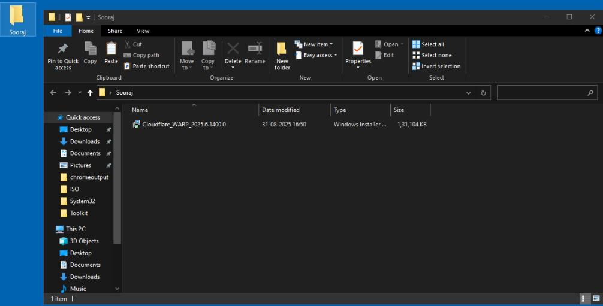
1. Initial Setup and Repackaging:
Step 1:Create a folder to save your repackaged MSI file.
STEP:1
STEP: 2
2025 - RPS Consulting all rights reserved

Slide 10
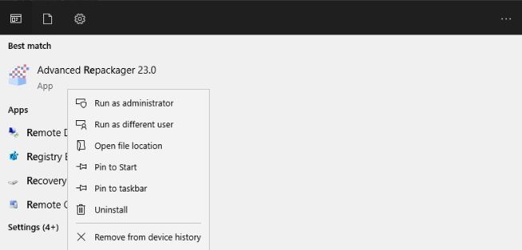
Step 2:Open the application repackaging tool.
STEP : 3 CLICK AND OPEN
2025 - RPS Consulting all rights reserved

Slide 11
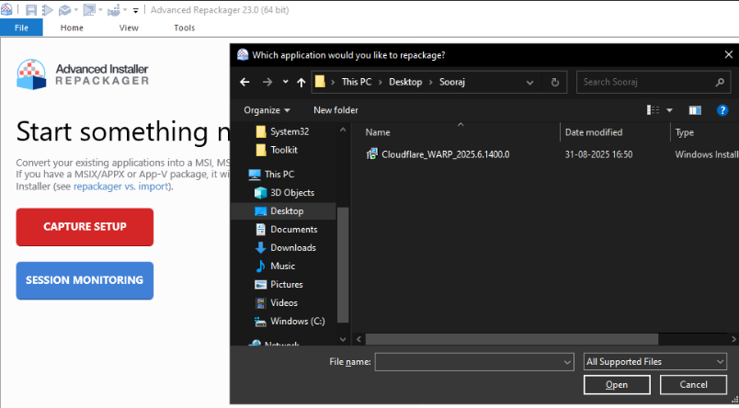
Step 3 :Click on "Capture Setup." Select the MSI file you want to repackage and provide a name for the output.
STEP : 4 CLICK ON “CAPTURE SETUP
STEP : 5 CLICK AND GIVE OPEN
2025 - RPS Consulting all rights reserved

Slide 12
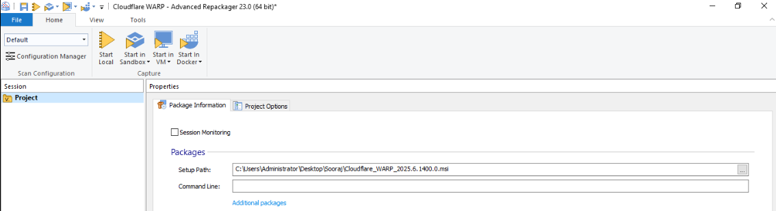
Step 4 :Click on "Start Local" to begin the capture process and save the MSI file.
STEP 6 : CLICK ON “START LOCAL”
2025 - RPS Consulting all rights reserved

Slide 13
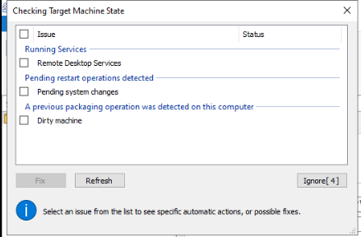
Step 5 : A pop-up window will appear. Click "Ignore" and wait until the repackaging is successful.
STEP 7 : CLICK ON “IGNORE”
2025 - RPS Consulting all rights reserved

Slide 14
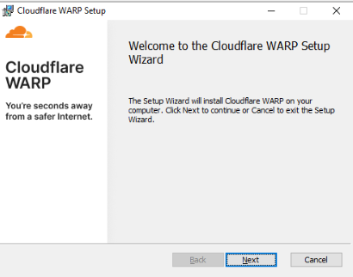
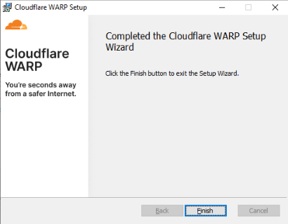
Step 6 : Another pop-up to install the MSI will appear. Click "Next" and then "Install."
STEP 8 : CLICK ON “NEXT”
STEP 9 : CLICK ON “FINISH”
2025 - RPS Consulting all rights reserved

Slide 15
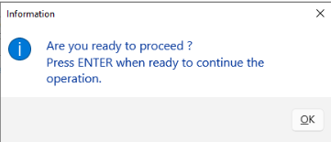
Step 7 : Click "OK" when the "Are you ready to proceed?" pop-up appears.
STEP 10 : CLICK ON “OK”
2025 - RPS Consulting all rights reserved

Slide 16
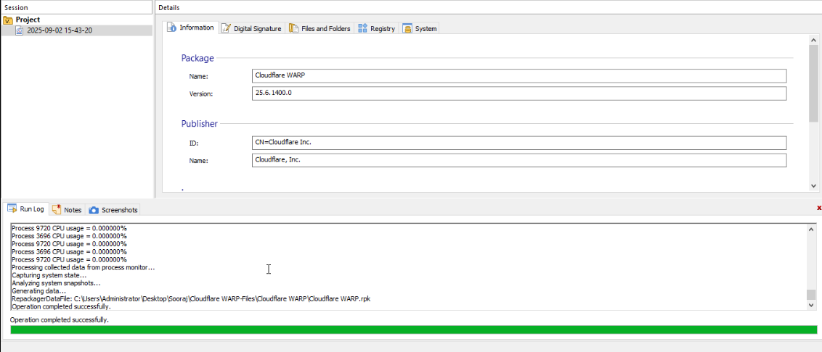
Step 8 : Wait until the operation is complete and successful.
STEP 11 : WAIT TILL ITS COMPLETE
2025 - RPS Consulting all rights reserved

Slide 17
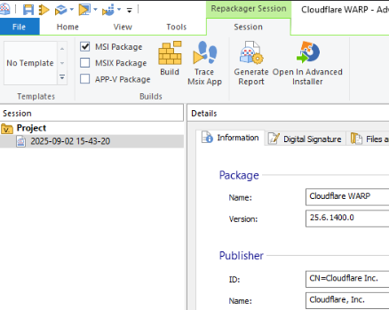
Step 9 : CLICK ON Open Advanced Installer and import the repackaged results. This will import the files and folders of the application.
STEP 12 : CLICK AND OPEN ADVANCE D INSTALLER
2025 - RPS Consulting all rights reserved

Slide 18
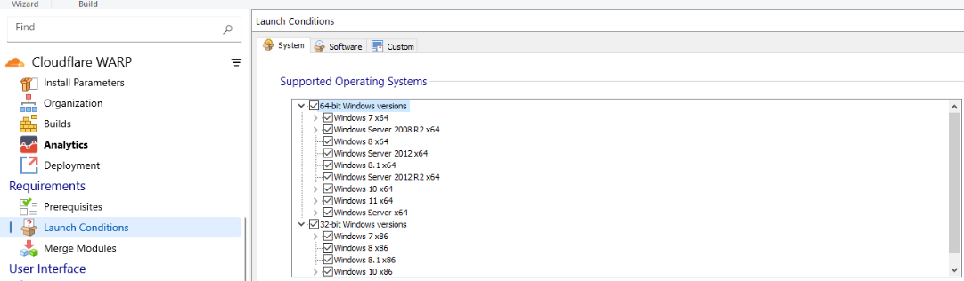
2. Configuring the Launch Condition:
Step 10 : Scroll down to and click "Launch Conditions."
STEP 13 : Launch Condition
2025 - RPS Consulting all rights reserved

Slide 19
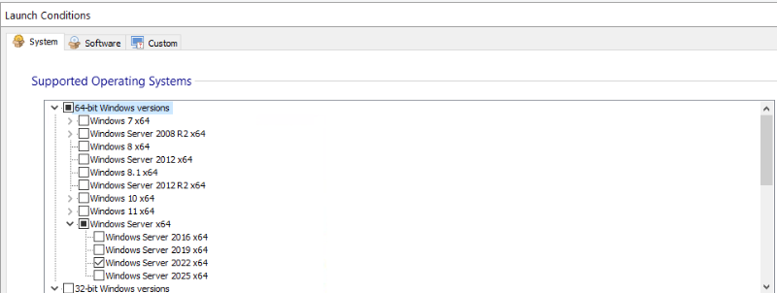
Step 11 : Under the System Software category, unselect the default "Any Windows Version" option Select the specific OS versions you want to allow, such as Windows Server 2022 x64 and Windows Server x64.
STEP 14 : CLICK ON SPECIFIC VERSION
2025 - RPS Consulting all rights reserved

Slide 20
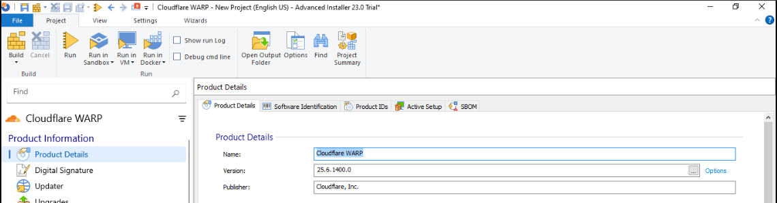
Step 12 : Go to "Product Details" and then click "Build."
STEP 16 : CLICK ON BUILD
STEP 15 : CLICK ON PRODUCT DETIALS
2025 - RPS Consulting all rights reserved

Slide 21
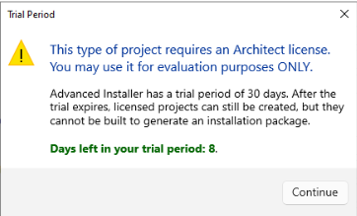
Step 13 : A pop-up will appear. Click "Continue."
STEP 17 : CLICK ON CONTINUE
2025 - RPS Consulting all rights reserved

Slide 22
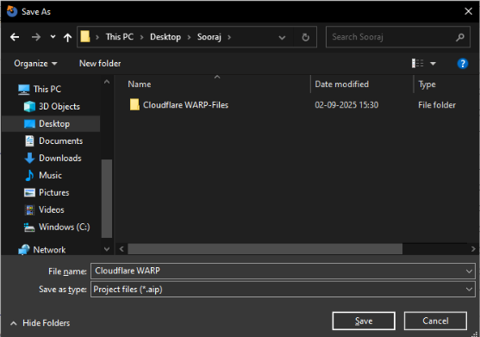
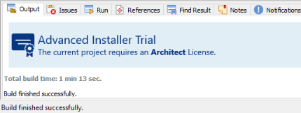
Step 14 : Save the final MSI file in your folder.
STEP 18 : CLICK ON SAVE
WAIT TILL ITS SUCCESSFULL
2025 - RPS Consulting all rights reserved

Slide 23

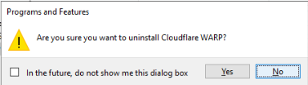
Step 15 : Uninstall the MSI file you just built.
STEP 19 : CLICK ON YES
2025 - RPS Consulting all rights reserved

Slide 24
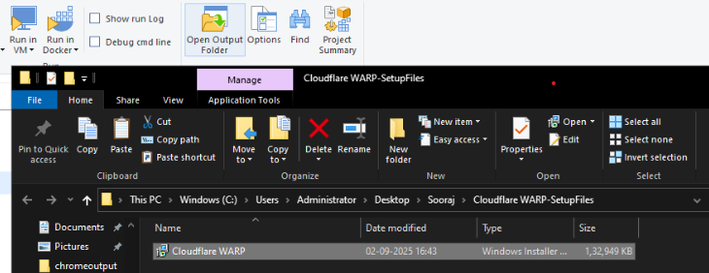
3. Testing the Installer:
Step 16 : Navigate to the output folder and double-click the newly built MSI file.
STEP 20 : CLICK ON OPEN OUTPUT FLODER
STEP 21 : CLICK ON MSI
2025 - RPS Consulting all rights reserved

Slide 25
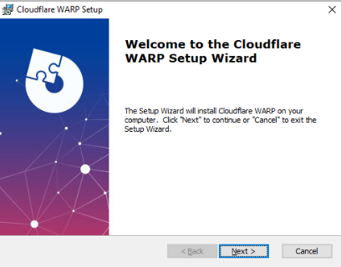

Step 17 : An "Installation Pop-up" will appear. Click "Next" and "Install" until it's done, then click "Finish."
STEP 22 : CLICK ON “NEXT”
STEP 23 : CLICK ON “FINISH”
2025 - RPS Consulting all rights reserved

Slide 26
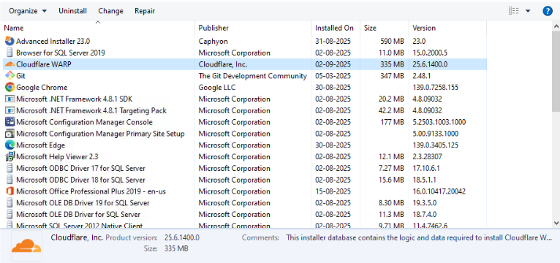
Step 18 : Check the "Control Panel" to confirm that the software is installed.
STEP 24 : MSI INSTALLED
2025 - RPS Consulting all rights reserved

Slide 27
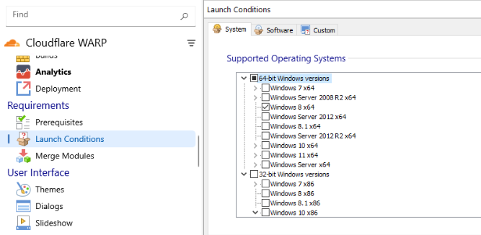
Step 19: To test launch condition, go to the "Launch Conditions" section again Select a random Windows version that is not on your current system.
STEP 26 : CLICK ON RANDOM VERSION
STEP 25 : CLICK ON LAUNCH CONDITION
2025 - RPS Consulting all rights reserved

Slide 28
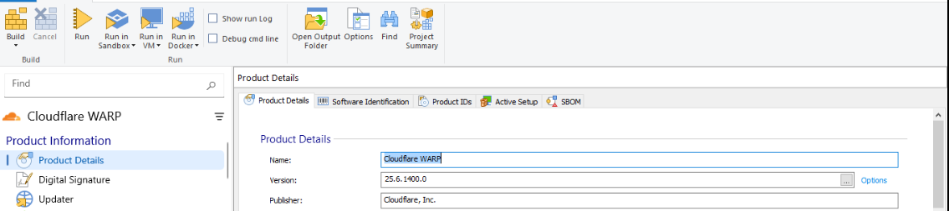
Step 20 : Go to "Product details" and then "Build."
STEP 27 : CLICK ON BULD
WAIT TILL MSI IS BUILD SUCCESSFUL
2025 - RPS Consulting all rights reserved

Slide 29
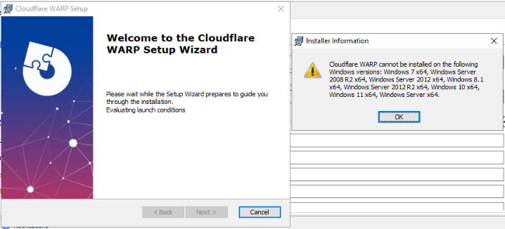
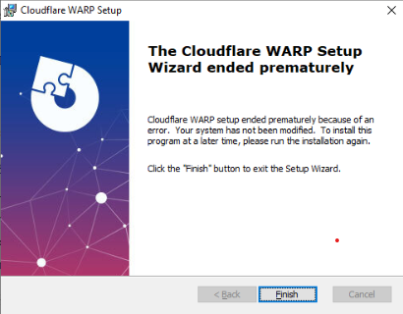
Step 21 : Click on the MSI file you just built. An error pop-up message will appear, stating that the application cannot be installed. This means your project and the launch condition are successful.
WE CAN SEE MSI COULDN’T INSTALL
WE CAN SEE THE ERROR POPUP
2025 - RPS Consulting all rights reserved

Slide 30
conclusion
This project used application repackaging to create a smart installer with a launch condition, preventing installation on unsupported operating systems and ensuring a reliable deployment.
2025 - RPS Consulting all rights reserved

Slide 31
Sources and references
https://www.advancedinstaller.com/user-guide/
https://learn.microsoft.com/en-us/windows/win32/msi/launch-conditions
2025 - RPS Consulting all rights reserved

Slide 32
THANK YOU
www.rpsconsulting.in

